Slide 1
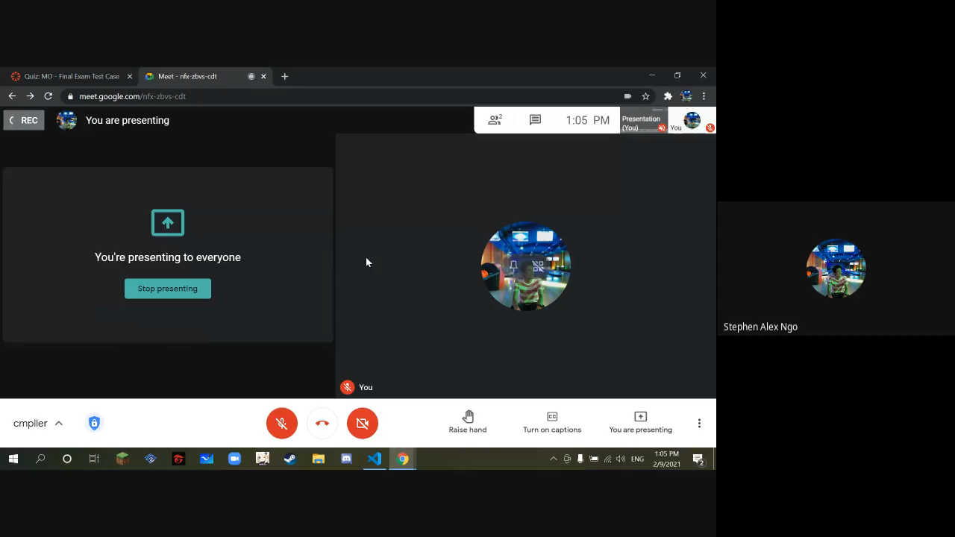
Stephen Alex Ngo
Section - S11
Video:

Slide 2
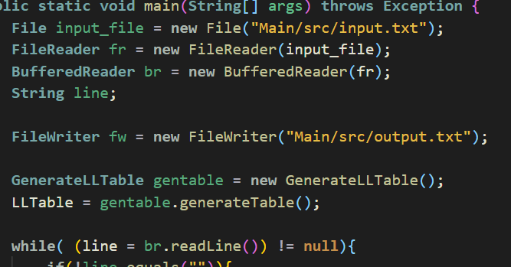
Lexical Analysis
First, I read the file which contains the sample input test cases given. Put all the texts in a buffered reader. After that,

Slide 3
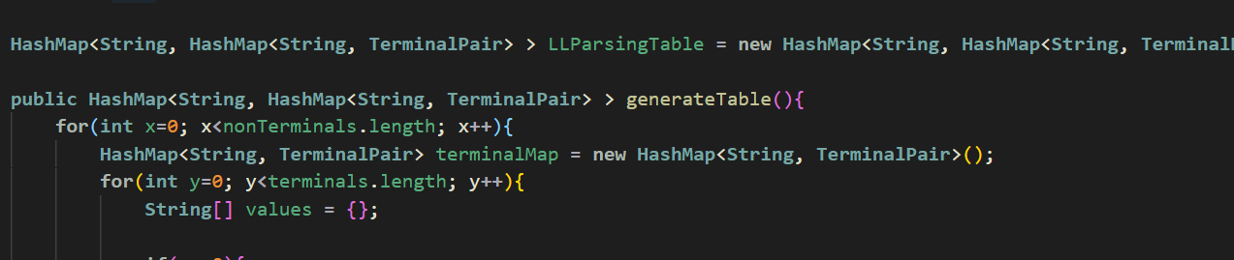
Lexical Analysis
Generate the LL1 parsing table which will be used in the simulation. I used Hashmap to represent the table

Slide 4
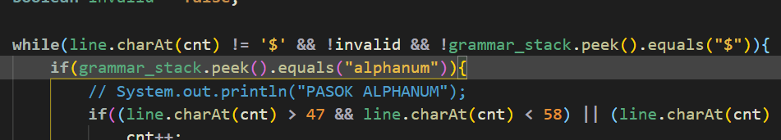
Maximal Munch
For the maximal munch, I just read per line of input then check until it reaches an error state or $ in the current input

Slide 5
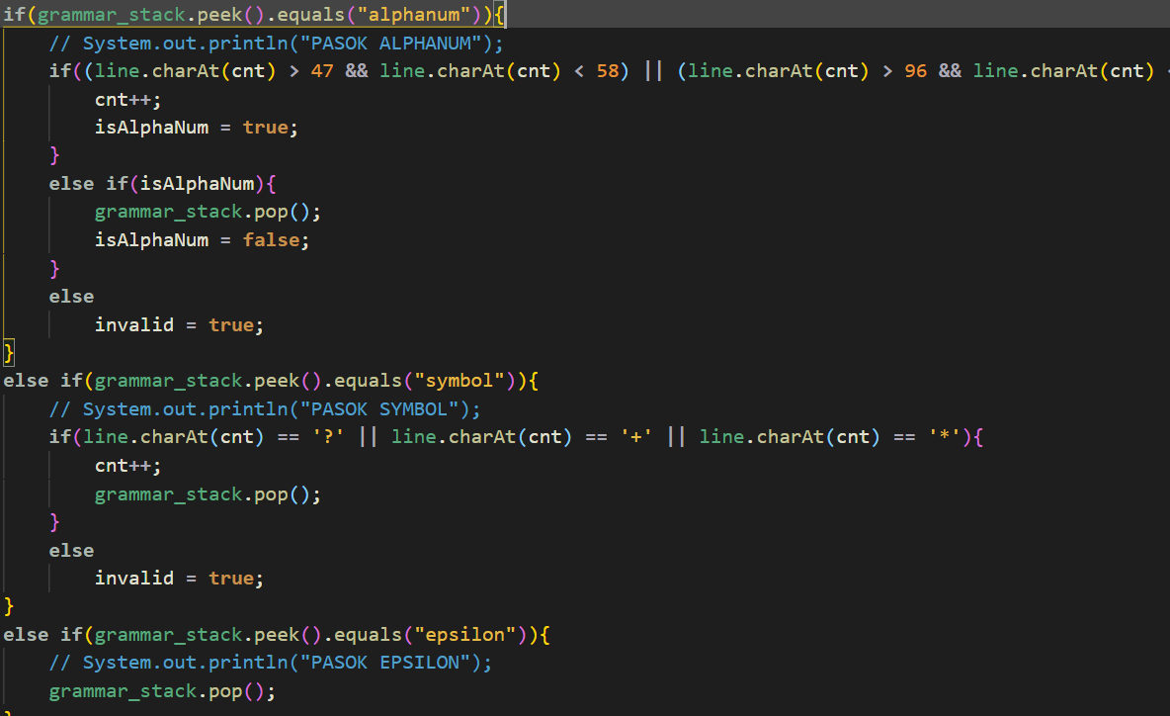
Token Recognizer
I recognizing token by when its equal to given ASCII codes for 0-9 and a-z then its an alphanum token , its equal to +?* then it’s a symbol and for U then union and E for epsilon

Slide 6
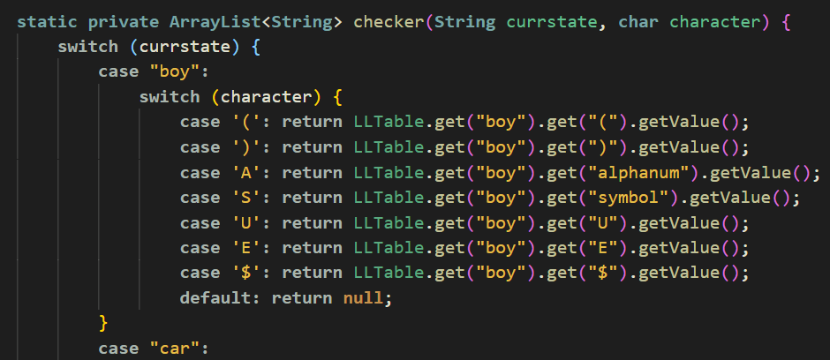
FSA
For the FSA, I represent my state as a non terminal node, then its transitions are the terminals, then it will go to the state for its corresponding value.

Slide 7
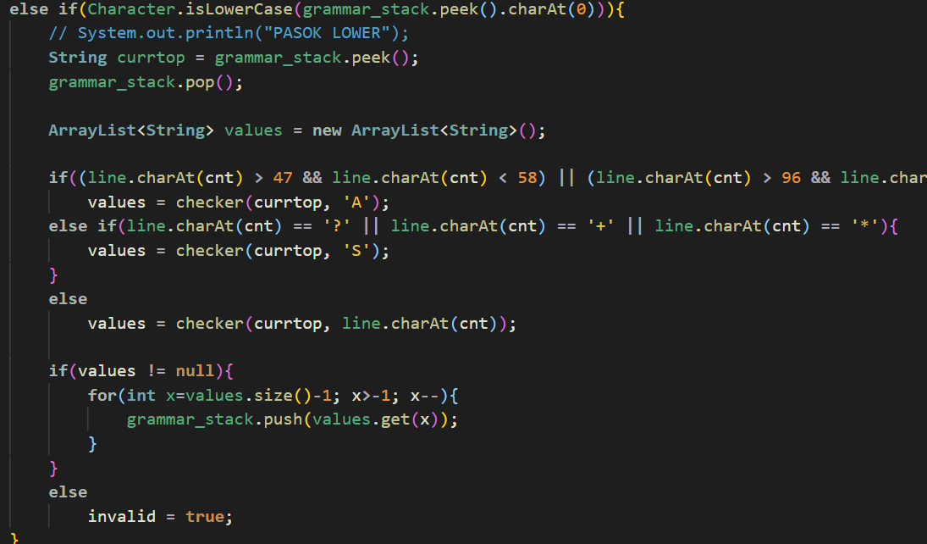
Syntax Analysis
This is where the Llone Parsing take part which if the top of the grammar is a non terminal then use the FSA to get its value from the Llone table.

Slide 8
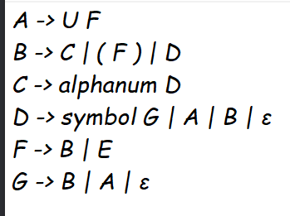
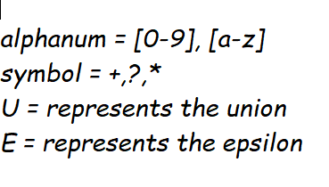
Grammar Rule

Slide 9
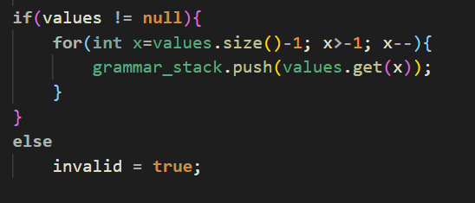
Error Recovery
If the return value when doing checking for value that will get from the LLONE parsing table is null then this will be an error.

Slide 10
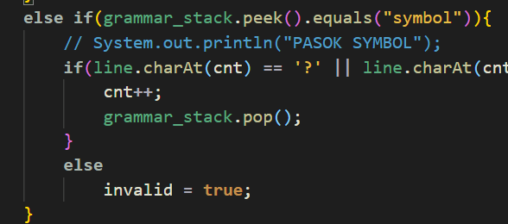
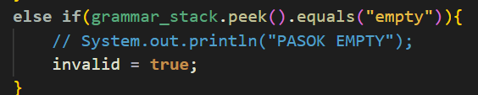
If the stack top is “empty” word then it will throw invalid, and if its symbol then current char input should be + or ? or *. Same goes for alphanum. Empty word represents no value in the LL parsing table for the given non terminal and terminal.

Slide 11
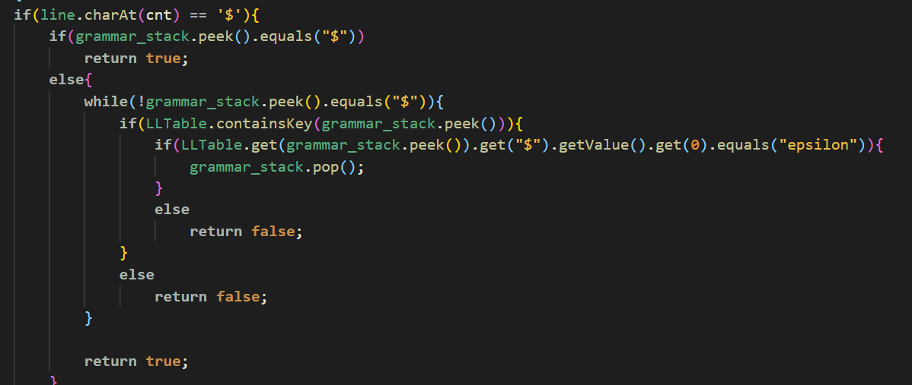
Check if both stack and input is not ending with $ then return error because $ represents end of input

Slide 12
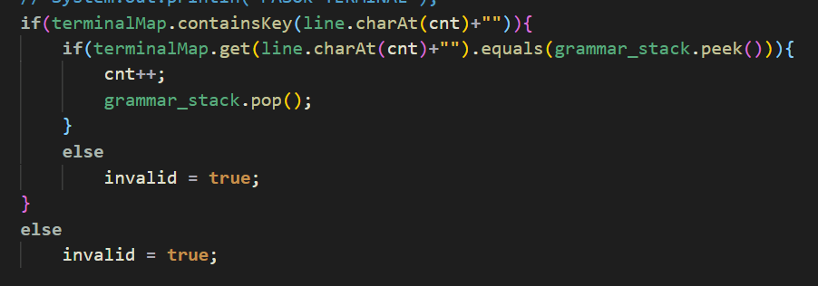
If the terminal is not equal to the input or not exists in the terminal Map then return error.

Slide 13
Thank you!! :D

